Slide 1
Approaches for
Priority Setting
Friday, June 3 1:00
Deborah Rosenberg, PhD
Research Associate Professor
Division of Epidemiology and Biostatistics
University of IL at Chicago School of Public Health
Training Course in MCH Epidemiology

Slide 2
The Landscape for Summarizing Data
For an MCH needs assessment, we are interested in multiple risk factors and outcomes, in different populations, and across different spheres:

Slide 3
The Landscape for Summarizing Data
Many data sources may contribute indicators to each cell of the matrix of population groups and domains:
      Census data
      vital records data
      Medicaid data
      hospital discharge data,
      WIC data
      client tracking system / encounter data
      focus group and other qualitative data,
      national and/or local sample survey data

Slide 4
The Landscape for Summarizing Data
And within and across data sources, multiple versions of an indicator can be selected for analysis
    Overall frequency of occurrence
    Overall rate of occurrence
    Subpopulation frequencies of occurrence
    Subpopulation rates of occurrence
    Geographic variation
    Time trend
    Combination of multiple related indicators
    Distance from a standard or goal

Slide 5
The Landscape for Summarizing Data
In addition, when small areas or small numbers are an issue, there are special considerations for the types of indicator values that will be used:
  Direct estimate from local survey
  Direct estimate from "non-local" survey
  Direct estimate from local population data
  Directly standardized estimate
  Indirectly standardized estimate
  Combination of direct and indirect estimates
  Synthetic estimate

Slide 6
The Landscape for Summarizing Data
Summarizing / analyzing quantitative data is part of a larger ongoing, iterative process of incorporating input from external stakeholders, analyzing that input, applying epidemiologic expertise to reconsidering the quantitative data.
This process differs from most epidemiologic research which focuses on testing one or only a few hypotheses.

Slide 7
The Landscape for Summarizing Data
Needs Assessment / Surveillance:
  Most often univariate and bivariate analyses, including time trend analyses
  Prevalence and incidence / crude & adjusted
  Minimal statistical testing
  v.
Research / hypothesis testing:
  Typically multivariable analyses, including regression modeling
  Measures of association—odds ratios, relative risks / prevalences
  Almost always statistical testing

Slide 8
The Landscape for Summarizing Data
From the Alabama, 2005 Needs Assessment:
“Quantitative and qualitative methods were used in the Needs Assessment. Particular analytic techniques varied according to the data source. Only some analyses included formal statistical assessment in the form of p-values ... or confidence intervals ... .
Unless stated otherwise in the description of methods for particular findings, neither confidence intervals nor statistical testing was performed. Many analyses focused on general pictures and, if available, patterns over time or across groups, rather than statistical precision ... .”

Slide 9
The Landscape for Summarizing Data
Needs assessment / Surveillance: Graphs and charts; fewer tables and brief narrative; presentation that facilitates cross-indicator comparisons
v.
Research / hypothesis testing: Tables and detailed narrative; fewer graphs and charts; presentation customized for the particular research question being addressed

Slide 10
The Landscape for Summarizing Data
The process of summarizing data within and across many domains and population groups is daunting unless a well defined analysis plan is articulated and implemented.
Without a systematic approach, it is likely that data will not be successfully translated into the information needed by program planners, managers, and policy-makers.

Slide 11
The Landscape for Summarizing Data
Data Rich
Information Poor

Slide 12
Analysis Considerations
Criteria | Weight | LBW | Peri HIV | Smoking
Magnitude | 2 | Crude Rate? Adjusted Rate? Stratum-specific rates? Extent of Disparity?
Trend | 3 | Average annual percent change: improvement, deterioration, no change? Crude? Stratified?
Severity | 3 | Quality of life? Long-lasting consequences? Cost?
Preventable | 2 | Efficacy? Success Rate? Cost?
Goal | 3 | National Goal? Local Goal?
Priority | 1
Acceptable | 2
How will we decide what data to use to fill in this table?

Slide 13
Analysis Considerations
For example, thinking about magnitude:
        Low incidence/prevalence
        Moderate in some subgroups
        Moderate in all groups
        High in some subgroups
        High in all groups
What will be the numeric definition of ‘low’, ‘moderate’, and ‘high’ for each indicator?

Slide 14
Analysis Considerations
Will the overall level of indicators be reported, or will a long series of rates for combinations of demographic, geographic, and/or time strata be reported, or something in between?
      By age, race/ethnicity, county, and year
      By age, race/ethnicity, and county
      By age, and race/ethnicity
      By age
      Overall for the state for one year

Slide 15
Analysis Considerations
In order to make decisions about how to report indicators, it is important to begin by examining the data in its most unsummarized form.
If decisions about how much summarization, and on which variables, are made without first looking at the “raw” data, important differences and disparities might be overlooked.

Slide 16
Analysis Considerations
For example, a decision might be made to present an indicator for children ages 0-17 stratified by race/ethnicity, when in fact, this indicator varies more by age than by race/ethnic groups.
Therefore, a more appropriate data summarization decision would be to present the data stratified by age and not by race/ethnicity. This would be clear if before any decisions, the data were examined in a variety of ways, e.g. single and multiple stratified analysis.

Slide 17
Analysis Considerations
Examining trend data may be important:
Different patterns over time and different
current values across groups

Slide 18
Analysis Considerations
For maternal mortality in IL, both the black-white disparity and older maternal age are of concern, and there may be interaction between these two risk markers. Which reporting approach will best inform the prioritization process?
The effect of older age is
present for all women, but is greatest among
African-American women.
The black-white disparity
is wide in both age groups,
and may be slightly wider among older women.

Slide 19
Analysis Considerations
Choices about which data to include in an analysis are highly dependent on both the availability of data and on its quality.
As MCH professionals, we can all name many indicators that would enhance our ability to carry out a comprehensive needs assessment, but data for these indicators are not available.

Slide 20
Analysis Considerations
For example, it would be very informative to report the incidence of child injury by type of injury and age. Since true incidence data are not readily available, however, hospitalization for injury or injury mortality are typically reported instead.
This imposes limitations on our analysis and on the prioritization process.

Slide 21




Analysis Considerations
Reliance on
proxy indicators
might bias the
prioritization process

Slide 22
Analysis Considerations
Similarly, although it is well accepted that analyzing the content or quality of prenatal care is critical to understanding the effectiveness of this service, generally only measures of the quantity of prenatal care such as the timing of the first visit and the total number of visits, are available for analysis.

Slide 23
Analysis Considerations
Sometimes we have to present more data than we would like because we need to use several less than optimal measures in an attempt to approximate the information that an indicator would provide if it were available.
Sometimes we use data of poor quality because no high quality alternative is available.
Perhaps most problematic, sometimes we mis-specify the questions we ask because of the constraints in the data.

Slide 24
Analysis Considerations
The level and type of data summarization will differ depending on the purpose of analysis:
        Comprehensive state-wide needs assessment
        Community-based needs assessment
        Indicator-specific analysis
        Program evaluation

Slide 25
Analysis Considerations
An epidemiologic perspective helps to weigh the advantages and disadvantages of different analytic strategies in order to choose the one that strikes the best balance between specificity and interpretability

Slide 26
Methods for Summarizing Data
Some analytic approaches used to summarize data for needs assessment and priority setting:
    Categorization—defining thresholds, benchmarking
    Ranking and Scoring
        Integer ranking
        Rescaling
        z-scores and z-tests
    Index/composite variable construction
    Regression analysis

Slide 27
Methods for Summarizing Data
Creating Meaningful Categories
Grouping indicator values into discrete categories alleviates the data burden by replacing many distinct values with a few summary ones.
In addition, giving intuitive labels to categorized indicator values aids in interpretation:
high, medium, low
above average, below average
excellent, good, fair, poor

Slide 28
Methods for Summarizing Data
Even when seemingly continuous variables are of interest, they are often transformed into discrete ones by defining appropriate categories.
  discrete categories may better capture distinct clinical, developmental, or programmatic groupings
  original ordering of a continuous variable is not applicable to a particular public health issue.

Slide 29
Methods for Summarizing Data
Categorization
can be carried out
for both individual
and aggregate data.
Defining categories
of necessity means
loss of information.

Slide 30
Methods for Summarizing Data
Examples of continuous variables
that might be categorized:
At the individual level: At the aggregate level:
Birthweight County Birthweight Rates
Maternal Age County % < 18; % > 35
Income County Median Income
Obesity / BMI County % Obese

Slide 31
Methods for Summarizing Data
Equal Counts: median, quartiles, quintiles
Equal Ranges: Instead of equal numbers of observations, equal portions of the range are used. If four categories are desired, the range is divided into four equal parts.
Naturally Occurring Breakpoints: clusters, standard deviation units
Conceptual Breakpoints: clinical, historical, cultural

Slide 32
Methods for Summarizing Data
The observed distribution of the data will dictate the appropriateness of categories
For uniformly distributed values, there is no difference between obtaining equal counts or equal ranges, but for a skewed distribution, the categories defined by the range will be very different than those defined by equal sample size.
Conceptual breakpoints may not take account of sample size.

Slide 33
Methods for Summarizing Data

Slide 34
Methods for Summarizing Data
Ranking and Scoring
Ranking and scoring methods, unlike categorization, do not reduce the number of distinct values, but the ordering and labeling that these methods apply adds information and meaning beyond what the original values could convey.
Each ranking / scoring approach has advantages and disadvantages, different balance between precision and meaning.

Slide 35
Methods for Summarizing Data
Integer Ranking
Simple ranking assigns integers to the sorted values of an indicator.
For instance, if 10 areas are to be ranked according to the percent of children living in poverty, the integers 1 through 10 would be assigned.
By definition, the differences between the ranks are uniform: the distance between rank 2 and rank 4 is equal to the distance between all other values that are two ranks apart.

Slide 36
Methods for Summarizing Data
Ranking with Percentile Rescaling
Translate the position of a value on one scale to exactly the same position on another.
For example, for an area poverty percent that is at the 25th percentile of all 10 counties, assign it the value of 2.5 along the range 0-10.
The percentile rescaled values are ranks in the same order as simple integer ranks, but the distances between them are not uniform; they mirror the relative distances in the original data.

Slide 37
Methods for Summarizing Data
Calculate the location of values on a scale of 0-100 (percentile).
Then, if desired, translate the percentile to a new range.
Choosing a particular range may aid interpretation

Slide 38
Methods for Summarizing Data
Ranking with Z-scores and Z-tests
z-scores are anchored by the mean and standard deviation of the original values, and rescaled such that the new mean is 0 and the new standard deviation is 1.
The distances between z-scores are not uniform—they correspond to points on the standard normal curve, with a theoretical range of approximately -3 to +3.

Slide 39
Methods for Summarizing Data
Ranking with Z-scores and Z-tests
z-tests are separate statistical tests of the difference between each area indicator and a standard; they are not points on one curve.
Both the order of the data and the relative distances between the data points are "adjusted" according to the varying population sizes in the areas of interest.
The values are determined by the "standard“ used for comparison; an external standard adds equivalence across indicators and within an indicator over time.

Slide 40
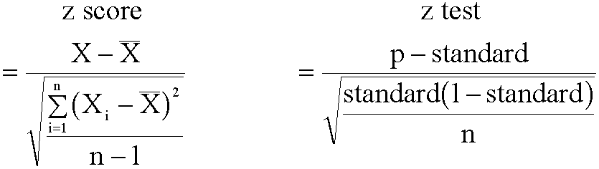
Methods for Summarizing Data
Z-scores treat indicator values as though they were individuals.
Z-tests treat indicator values as summary statistics.
the mean is the the standard is the overall
mean of the indicators indicator value
n=# of indicators n=# in pop. being tested

Slide 41
Methods for Summarizing Data
Composite Measures
Handle collinearity while preserving information
Improve Interpretability—more informative
Avoid potential bias in single variables
At the individual level: At the aggregate level:
        pnc utilization neighborhood resources
        SES County SES
        age-education Baby Friendly hospitals
        birthweight-gestational age city pollution
        body mass index county risk status
        severity index

Slide 42
Example:
Aggregate Data
Low Birthweight Rates for 10 Areas:

Slide 43
Example:
Aggregate Data
Two possible
ways to
categorize
area LBW
rates.

Slide 44
Example:
Aggregate Data
Percentile Rescaling
As an illustration, the percentile position of Area H's low birthweight rate of 7.75 is:
And this percentile translated to
a scale from 1 to 10 is:

Slide 45


Example:
Aggregate Data
Mean of the 10 lbw rates:
Standard deviation of the 10 lbw rates:
Overall lbw rate (weighted mean) of the 10 areas:

Slide 46
Example:
Aggregate Data

Slide 47
Example:
Aggregate Data
Composite Measures
Count of LBW births and the LBW rate:
Re-rank using the average of the ranks on the 2 variables
Current LBW rate and trend over time:
LBW rate below the median, rate decreasing
LBW rate above the median, rate decreasing
LBW rate below the median, rate constant or increasing
LBW rate above the median, rate constant or increasing

Slide 48
Methods for Summarizing Data
When choosing any of these approaches—categorization, ranking, rescaling, scoring, index construction—it is important to think about the advantages and disadvantages when the approach is extended to jointly assessing multiple indicators.
For example, integer ranking may be an appropriate approach for one indicator, while percentile rescaling may be a more reasonable approach for another. How will these two indicators be compared?

Slide 49
Methods for Summarizing Data
When comparing different indicators, as opposed to one indicator across different areas, ranking and scoring approaches can also be used, but have to be somewhat modified.
For example, rank according to distance from a goal or standard, but how will relative distance be quantified?

Slide 50
Methods for Summarizing Data
Without incorporating some external standard or benchmark, comparisons across many indicators and/or across time is difficult.

Slide 51
Methods for Summarizing Data
Comparisons across indicators may be based on the intersection of trend data and the distance from a standard or longer-term goal.

Slide 52
Methods for Summarizing Data
Different patterns over time and
different distance from long-term goals

Slide 53
Methods for Summarizing Data
Create Composite Variables that Combine Variables Across Indicators or Domains
Combine across health status indicators, e.g. combine child fatality, child obesity, and child oral health to get a more global child health index
Combine across health service indicators, e.g. utilization of well child care, acute care, and specialty services to get a more global service utilization index

Slide 54
Methods for Summarizing Data
Combine health status and health service variables for one indicator
    health status improving, services constant or increasing
    health status improving, services decreasing
    health status deteriorating, services constant or increasing
    health status deteriorating, services decreasing
  to get a more global index of whether services are effective in addressing health status issue

Slide 55
Methods for Summarizing Data
Data quality: some indicators are based on high quality data; others are not
Data availability: some domains have multiple measures; others only a few or none
Conclusions about priority differ by population groups
Conclusions about priority differ by geography
Conclusions about priority differ by qualitative judgment
How will these issues be handled
in the priority-setting process?

Slide 56
Examples from the Field
Illinois Child Health Needs Assessment
Select indicators within four domains:
    demographic risk indicators
    child health status indicators
    health service resources
    health service utilization measures
Rank counties on each indicator according to percentiles of the observations.
Compute mean ranks for each area using indicators within a given domain.
Re-rank counties according to these multiple-indicator mean ranks.

Slide 57
Examples from the Field
Connecticut Mat. & Infant Health Surv. Report,
1. Selected 6 indicators.
2. Statistically compare each indicator by town/health district to the statewide average.
3. Examine changes over time, using single years for large areas and two years combined for smaller areas.

Slide 58
Examples from the Field
4. Identify "problem" areas--indicators significantly worse than the state and deteriorating over time; identify "improved" areas--indicators historically worse than the state, but improving over time.
5. Report significant disparities within an area—those in which one population group is significantly higher than the state value on an indicator while another population group is significantly lower than the state value.

Slide 59
Examples from the Field
Health Status/Health Need Ranking of the Mass. Communities: A Methodology for Needs Assessment
Select indicators.
Assign scores to communities based on percentile rescaled values of each indicator.
Sum the scores across indicators to obtain a cumulative rank score.
Plot the distribution of the cumulative ranks.

Slide 60
Examples from the Field
    Massachusetts, cont.
5. If the distribution is approximately normal, categorize areas according to z-scores:
    ‘lowest status/highest need’ > 2
    ‘low status/high need’ 1 to 2
    ‘average’ 1 to -1
    ‘high status/low need’ -1 to -2
    ‘highest status/lowest need’ < -2

Slide 61
Examples from the Field
Rhode Island: Methodology for identifying communities in need of expanded WIC services (Buechner, et al.)
1. Select risk indicators and birth outcome indicators for each census tract in the state.
2. Use principal component analysis to combine census tract indicators into composite indices of MCH risk and adverse birth outcomes.
3. Use cluster analysis to define groups of census tracts according to their scores on these indices.

Slide 62
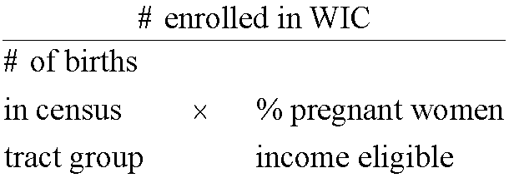
Examples from the Field
4. Calculate WIC coverage rates for each group of census tracts:
5. Analyze the variation in the coverage rates among census tract groups (ranging from 46% to 100%) in order to target outreach efforts.

Slide 63
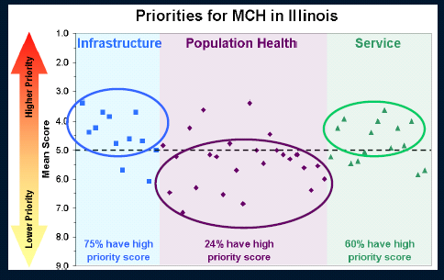
Examples from the Field
Excerpts: analysis and interpretation of q-sort results in IL
Presented in order to facilitate the priority setting process
Infrastructure: inter-agency
collaboration, insurance
coverage, integration
of data systems
Population Health: health
status outcomes,
e.g. infant mortality
Service: family planning,
mental health, prenatal care

Slide 64
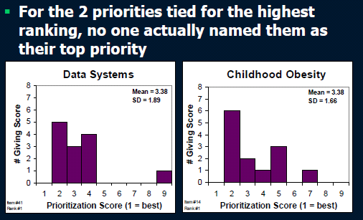
Examples from the Field
Not enough to show mean scores—
plot histograms of responses to identify consensus, disagreement, or other features of the distribution

Slide 65
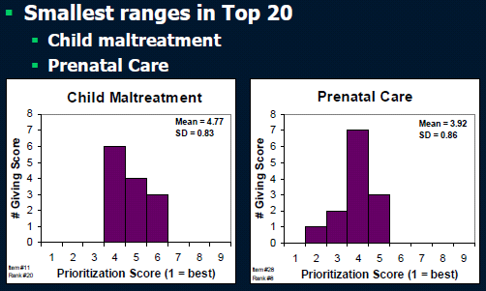
Examples from the Field
Agreement: the mean is a good representation

Slide 66
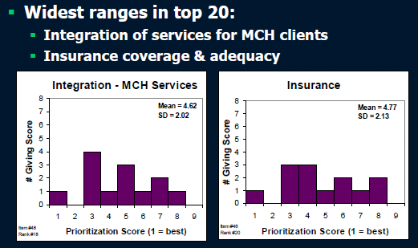
Examples from the Field
Disagreement: the mean does not represent consensus

Slide 67
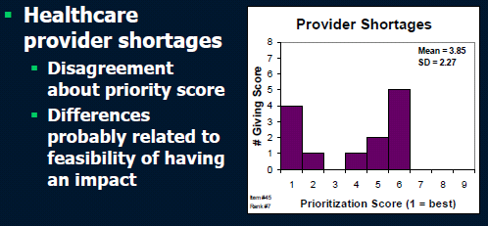
Examples from the Field
Interpretation about Split Opinion

Slide 68
Examples from the Field
Illinois Breastfeeding Blueprint
http://www.ilbreastfeedingblueprint.org/filebin/pdf/HC1_booklet_web.pdf
Organize data into sections:
  Individual level data
    —initiation, duration, exclusivity
    Hospital practices
    Summary: Patterns of breastfeeding, jointly considering initiation, duration and exclusivity
    Data Appendix

Slide 69
Examples from the Field
Examples of analytic decisions
Use life table analysis for duration and exclusivity
combine years in order to have enough sample size among Asians and Hispanics to crossclassify by income and race/ethnicity
create a low income measure based on an algorithm using multiple variables
Keep the narrative at a conversational level. For example, mostly use the syntax of “6 in 10” rather than 60%
Do not include regression results in the main report

Slide 70
Examples from the Field
For initiation, graphs and accompanying narrative
  Overall trend in initiation over time
  Trend over time in initiation by income level
  Trend over time in initiation by race/ethnicity
  Combined recent years, % initiation , by crossclassification of income and race/ethnicity (increased sample size)
  Barriers to initiation

Slide 71
Examples from the Field
For duration, graphs and accompanying narrative
  Overall pattern of duration from birth to 12 weeks
  Pattern of duration 0-12 weeks by income level
  Pattern of duration 0-12 weeks by race/ethnicity
  Combined recent years, % duration >=12 weeks, by crossclassification of income and race/ethnicity (increased sample size)
  Barriers to duration

Slide 72
Examples from the Field
For exclusivity, graphs and accompanying narrative
  Overall pattern of exclusivity from birth to 12 weeks
  Pattern of exclusivity 0-12 weeks by income level
  Pattern of exclusivity 0-12 weeks by race/ethnicity
  Combined recent years, % exclusive >=12 weeks, by crossclassification of income and race/ethnicity (increased sample size)
Hospital Practices
  Practices in IL hospitals
  Comparison of Illinois to other states—nation rankings

Slide 73
Examples from the Field
Data Appendix
  Description of data sources
  Description of analytic decisions
  Separate analysis of WIC clients
  Separate analysis of Hispanic women using a proxy of acculturation
  Regression analysis of the associations between hospital practices and duration and exclusivity

Slide 74
Examples from the Field
Georgia 2010 Needs Assessment
Review and analysis of quantitative data;
Collection of current qualitative information on consumer and stakeholder views of the health care needs of women, children, infants, and children with special health care needs;
Engagement of current and potential partners...through a day‐long focus groups meeting specifically for representatives from statewide professional associations, advocacy organizations, academia, and service organizations;
Focus group on the needs and health care priorities of infants and young children...with steering comm. of Early Childhood Comprehensive System (ECCS);

Slide 75
Examples from the Field
Needs assessment dialogues between the MCH Director and state agency leaders, resulting in new partnerships and activities;
MCH program staff develops a list of 55 needs from the focus group themes, as well as others they thought were important but not addressed by the qualitative data
Survey of physicians and District Health Directors and a separate survey of all public health agency staff (MCH and non-MCH) . Respondents were asked to select top 15 needs.
Items ranked in the top 15 by at least 20% of the approximately 350 survey respondents moved on to the prioritization exercise in the next stage – 44 priorities met this criteria. “

Slide 76
Examples from the Field
“The quantitative data analyzed for the 2010 Needs Assessment represents the single most comprehensive report of the state of the health of MCH populations currently available in Georgia. More than ten unique sources of quantitative data were analyzed as part of the 2010 Needs Assessment. Trends over time were presented for all data sources for a period of time for which data were available and accessible. Where possible, data were stratified by age, race/ethnicity, maternal educational attainment, and/or sex; and maps were included that displayed point estimates for each of the public health districts.”

Slide 77
Summary
Two Approaches for Reducing the Data Burden
  directly by limiting the amount of data analyzed and reported—restricting the number of indicators or values reported
  indirectly by increasing the interpretability of the data--transforming the data in ways that make it easier for an audience to assimilate
Typically, both approaches are used in combination

Slide 78
Summary

